Slide 1
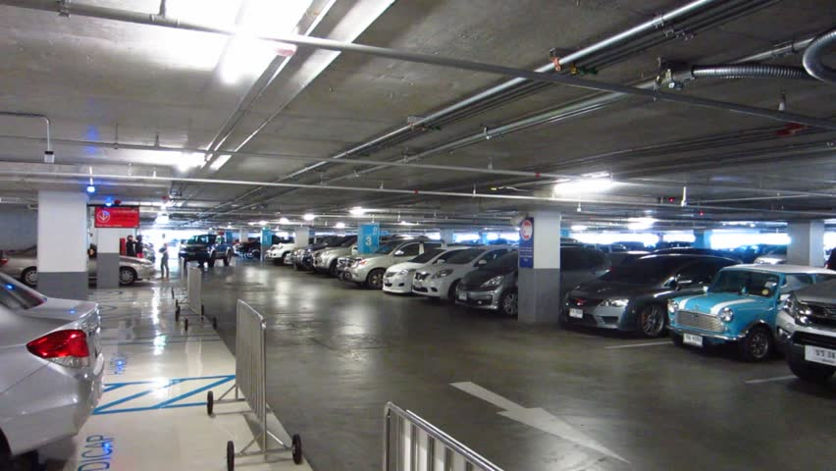

SMART VEHICLE PARKING SYSTEM FOR DIGITAL INDIA
SPOILERS PRESENT’S

Slide 2
Introduction:- Technological advancements have led the advancement and prevalence of Wireless Sensor Networks (WSN) in many of man's activities. The WSN consists of numerous low-costing sensor nodes that are organized to establish an ad hoc network via a wireless communication module that is equipped on the nodes. The sensor nodes are equipped with different sensors, computation units, and storage parts to collect cooperatively, process and provide sensory data for localization and surveillance…………..

Slide 3

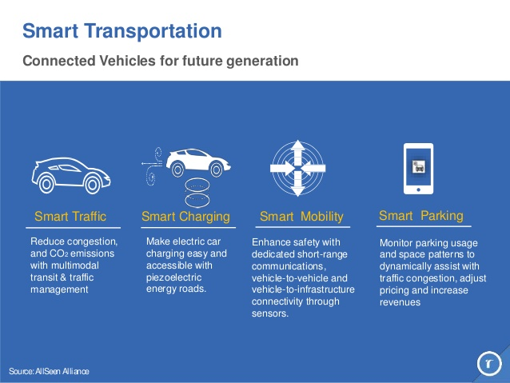
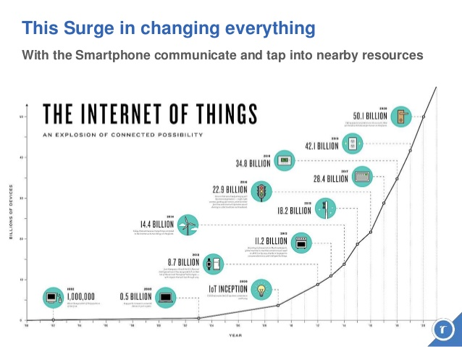
KEY CONCEPTS:- *Smart Transportation *Use of IOT

Slide 4
CHALLENGES:-
TIME LAPSING.
PROPER DEVICE MANAGEMENT.
SERVER DATA STORAGE.
WIRELESS CONNECTION:
STRONG CONNECTION REQUIRED.
24*7 SERVER HAS TO BE ACTIVATED.
SENSORS DETECTION SHOULD BE STRONG.

Slide 5
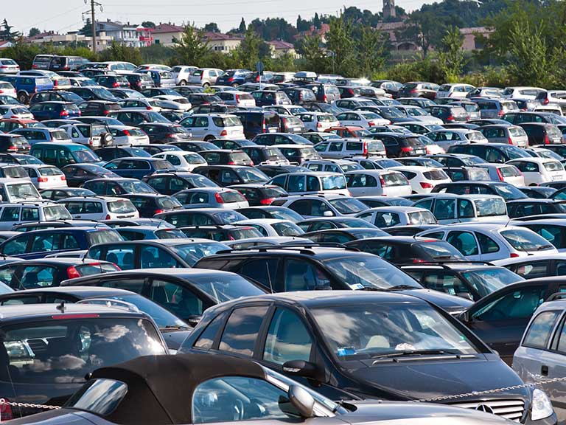


WHY WE NEED SMART PARKING SYSTEM?
Smart Parking systems provide options to car owners for parking lots. This helps in efficient management of parking space. This helps to manage the space efficiently. According to a recent research, 30% of the traffic in urban areas is caused by drivers and motorists looking for parking spaces…
NOW A DAYS, We are facing a high rate of parking problems because of INCREASING NO. OF VEHICLES AS WELL AS POPULAITONS…
BENEFITS OF SMART PARKING:-
Fuel saving.
Optimized parking.
Reduced traffic.
Reduced pollution.
Enhanced User Experience.
New Revenue Streams.
Integrated Payments and POS.
Real-Time Data and Trend Insight.

Slide 6
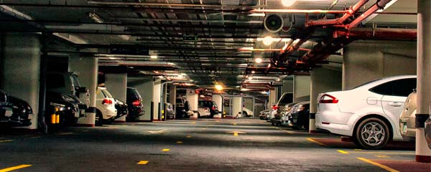
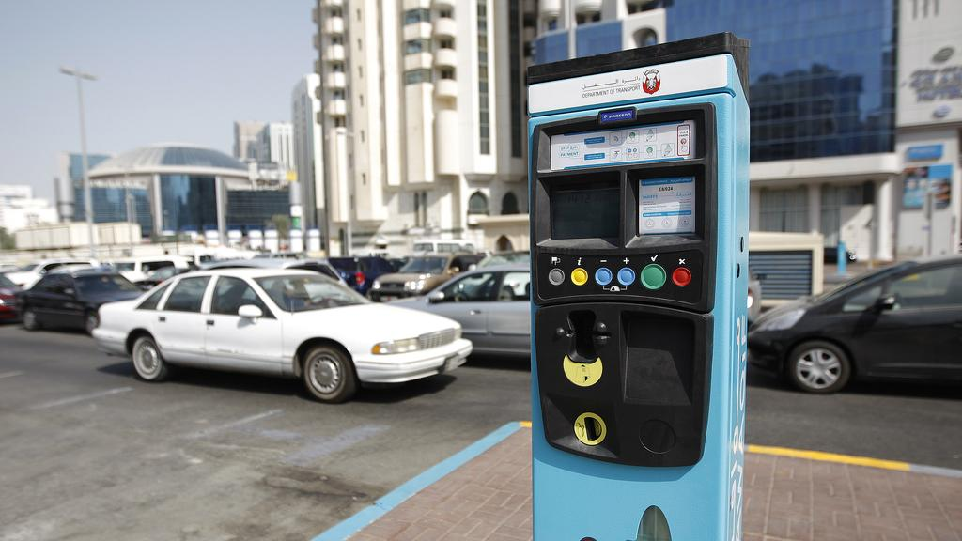
NEW SCHEMES FOR PARKING:-
PRIVATE PARKING
SYSTEMS.
PAID PARKING.

Slide 7
AN OVERVIEW OF OUR SYSTEM:-
USER
(BY APPLICATION AND WEBSITE)
DATA ENTRY IN SERVER
START
SENSOR
(S1) DETECTION
EXIT GATE OPEN
ADMIN
AT EXIT
AT ENTRY
MOTOR
(M1) COMMAND
COMMAND MOTOR (M2)
ENTRY GATE OPEN
DATA ENTRY IN SERVER
SENSOR (S2)
DETECT
AT PARKING

Slide 8

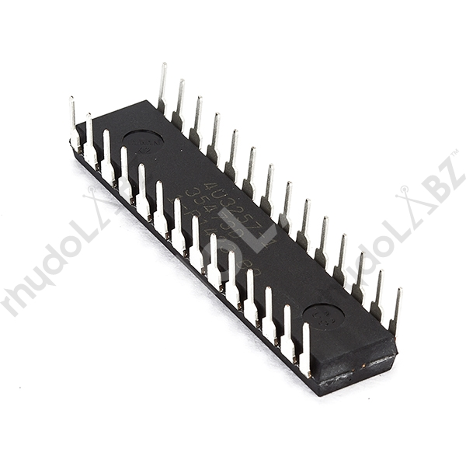
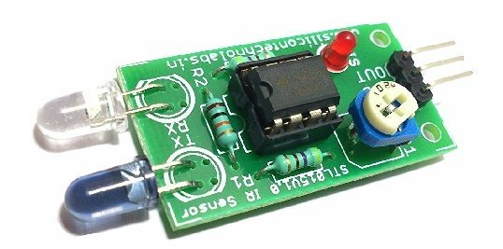
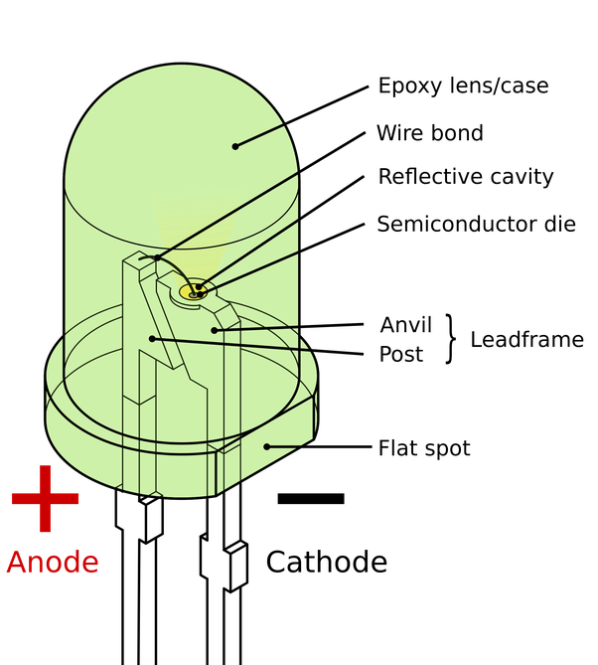
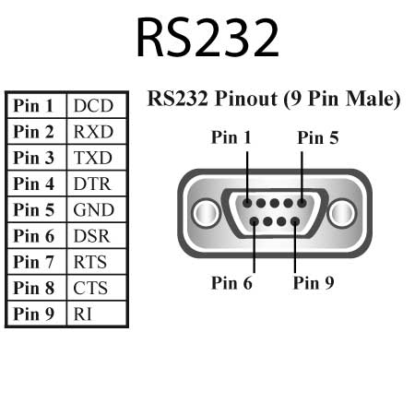
REQUIREMENT ANALYSIS:-
PDIP:-PROGRAM DEVELOPMENT INTGRATION PLAN
IR:-INFRARED SENSORS
LED:- LIGHT EMITTING DIODE
RS-232:-Recommend Standard

Slide 9
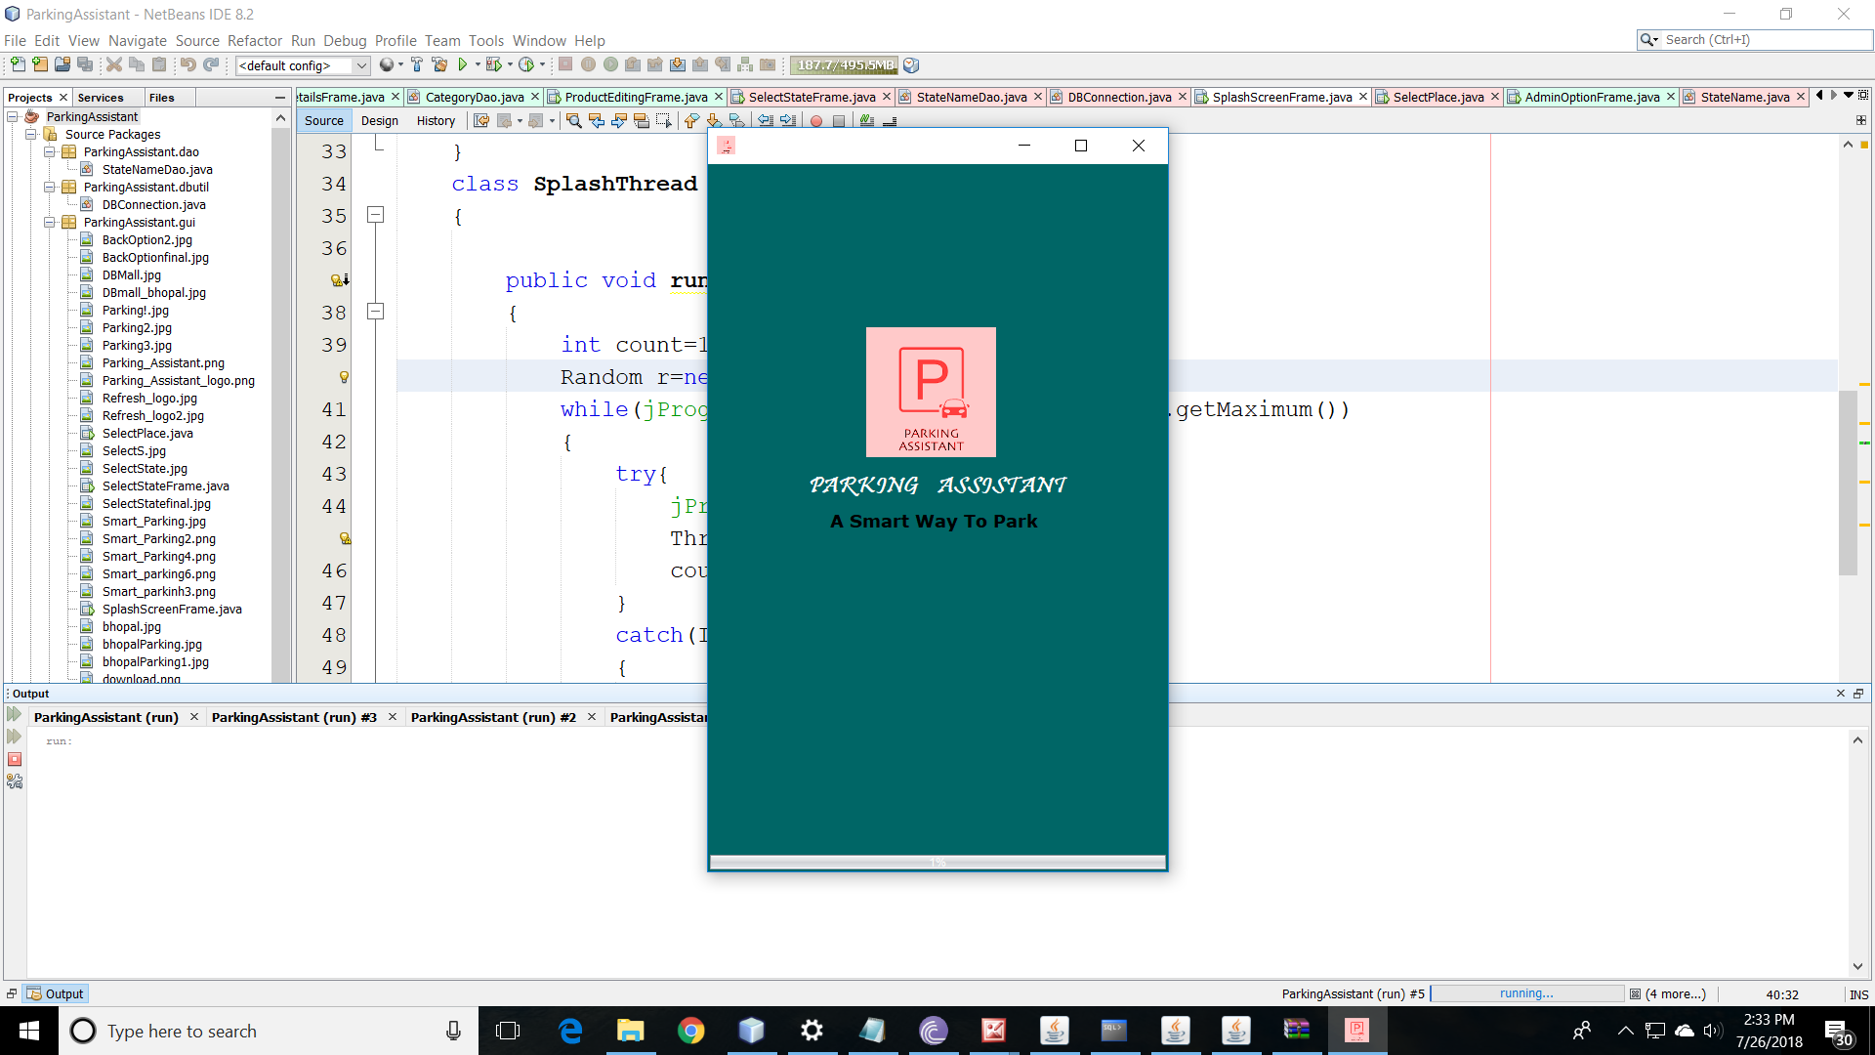
DESKTOP APP FOR SMART PARKING NAMED ParkingAssistant

Slide 10
ITS ALL FROM OUR SIDE……..
THANKING YOU

